Slide 1

Agile 4-DB Systel
Capacity Vs Velocity
Neeraj Vohra

Slide 2
The Difference between Velocity, Capacity, and Load
As you know Scrum is based on empiricism — All that is known is based on experience or evidence. Hence velocity in the scrum defines the amount of work a team has successfully completed in the past sprint(s).
Velocity is the measure of work that is done in the previous sprint(s).
Velocity is a measurement of the average amount of story points delivered in a given time period. Planning based on velocity means basing your estimates on past performance, i.e., an estimate relative to the measured past.
Capacity is an estimate of the total amount of engineering time available in a given sprint. Planning based on capacity means planning based on future expectations of available time, i.e., an estimate relative to the expected future.

Slide 3
The Difference between Velocity, Capacity, and Load
Capacity is the expected availability of the team members during the upcoming sprint.
Capacity is an estimated value that potentially can be delivered that is determined during PI planning. It is based on Velocity and modified for the realities of anticipated holidays, staffing absences or changes. If our velocity was 40, but the US Thanksgiving holiday falls in the next sprint, we might use a capacity of 25 while our velocity remains unchanged at 40. The velocity, itself, is unchanged since it is the calculated average of past performance.
Capacity is an estimate of the future; velocity is a measurement of the past.
Load is the committed value of the number of points the team intends to deliver in a sprint or PI. It is based on team capacity and the stories available in the backlog. we can also include stretch user story in a sprint. .

Slide 4

Capacity Vs. Velocity
velocity and capacity are 2 factors that the team needs to consider while pulling in product backlog items in the sprint backlog.

Slide 5
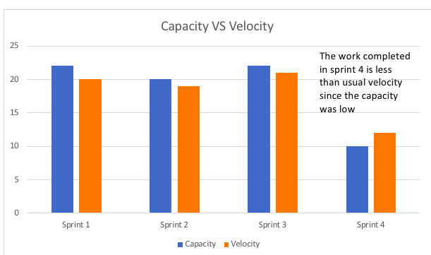
Capacity Vs. Velocity
Ideally, capacity and velocity work in conjunction. Velocity measures what a team is doing, on average, over time, and capacity estimates what a team is actually able to do in the next sprint (whether that be above or below average).

Slide 6
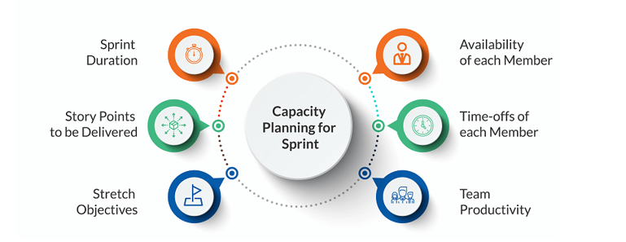
How to Perform Capacity Planning for Sprints?

Slide 7
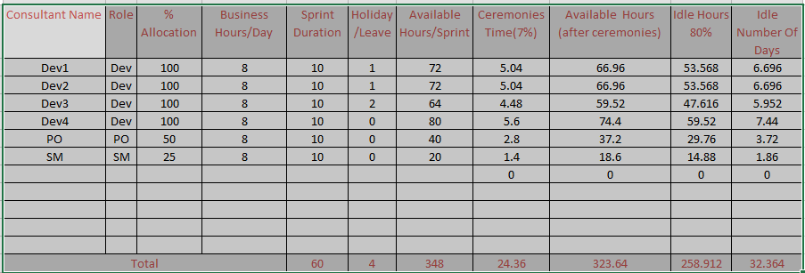
Capacity Vs. Velocity

Slide 8
Capacity Vs. Velocity (Explain)
Imagine we have 9 team members, who work within 2-week Sprints 40 hours a week. The maximum Team’s Capacity is: 9 * 2 * 40 = 720 hours.
Now imagine, 1 software engineer and 1 business analyst are going to have their 2-week vacations during the next Sprint and all the team will be away on holiday. So, the adjusted Capacity is: 720 − (2 * 40 * 2 + 9 * 8) = 720 − 232 = 488 hours.
The ratio is: 488 / 720 = 0.68
If the average Velocity for the previous three Sprints was 160 points. Then the refined forecast for the upcoming Sprint is: 160 * 0.68 = 109 points.

Slide 9
Thank You

